Slide 1

MSBD5001 Proposal Presentation
Group 17
CHONG Ka Hung 20543539
GAO Han 20565848
XU Yanhui 20549583
WANG Yuton 20541402
YANG Yue 20549600

Slide 2
Problem Explored

Slide 3
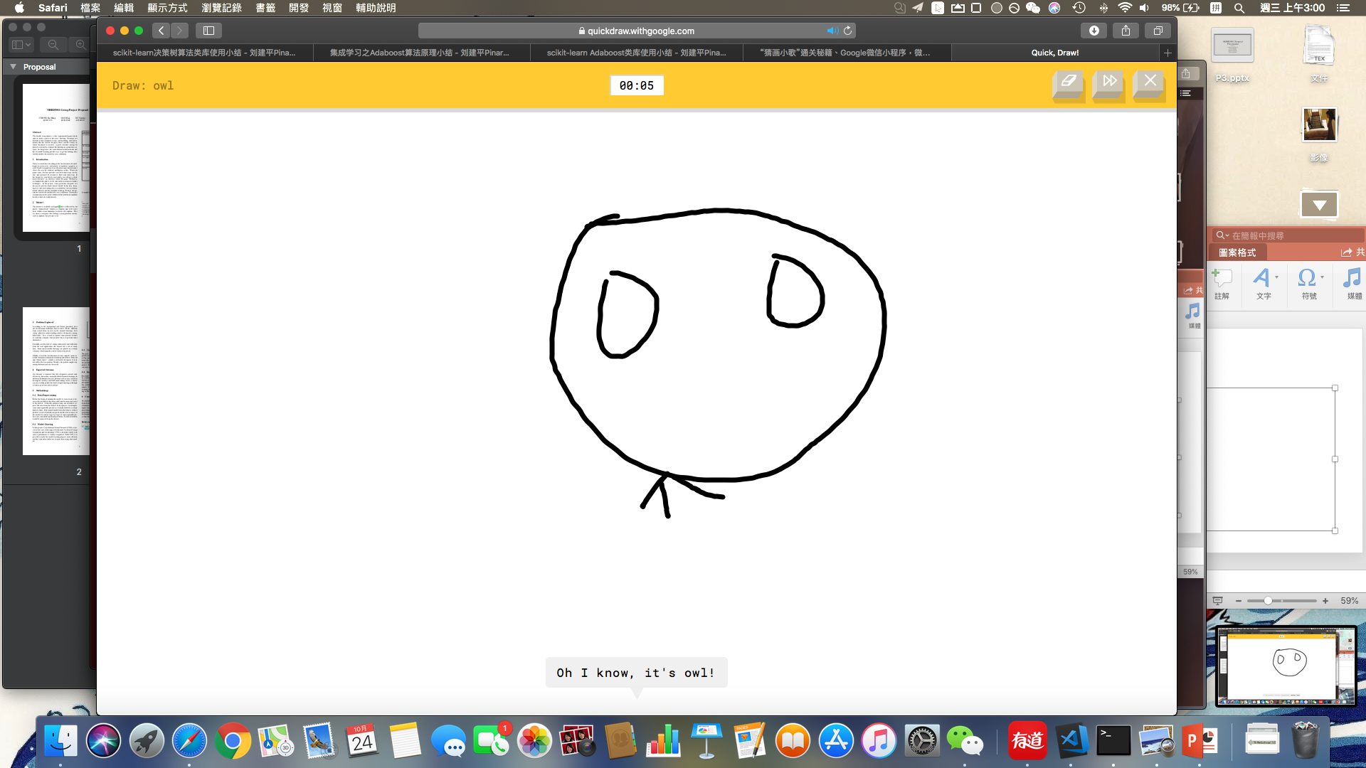
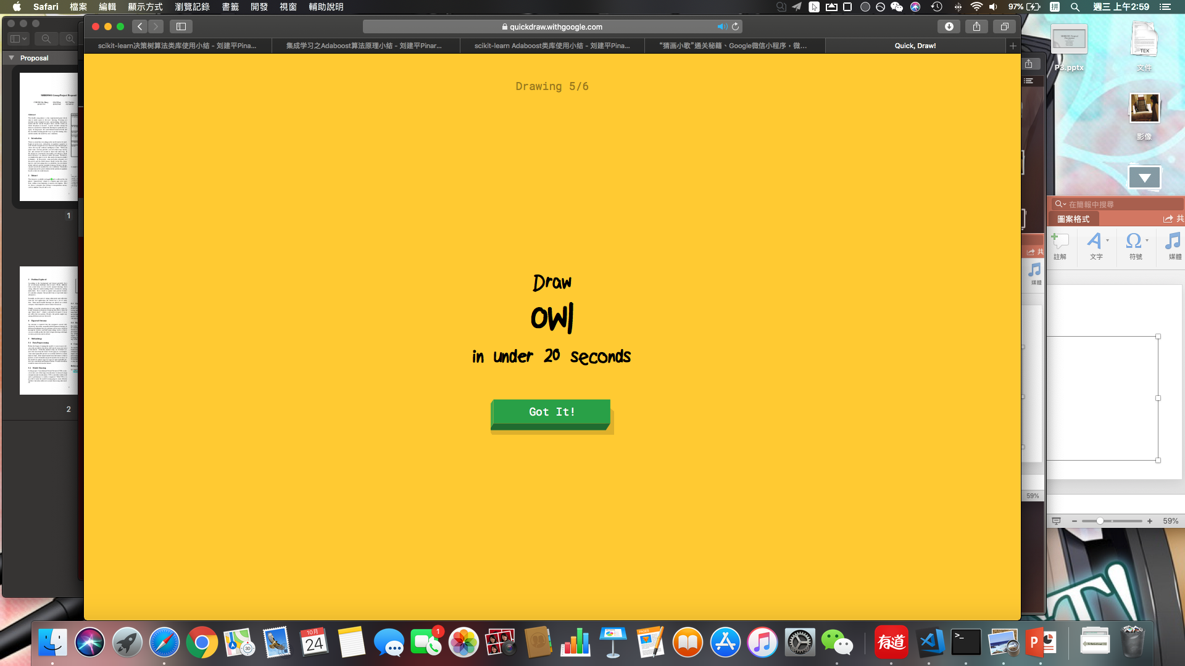
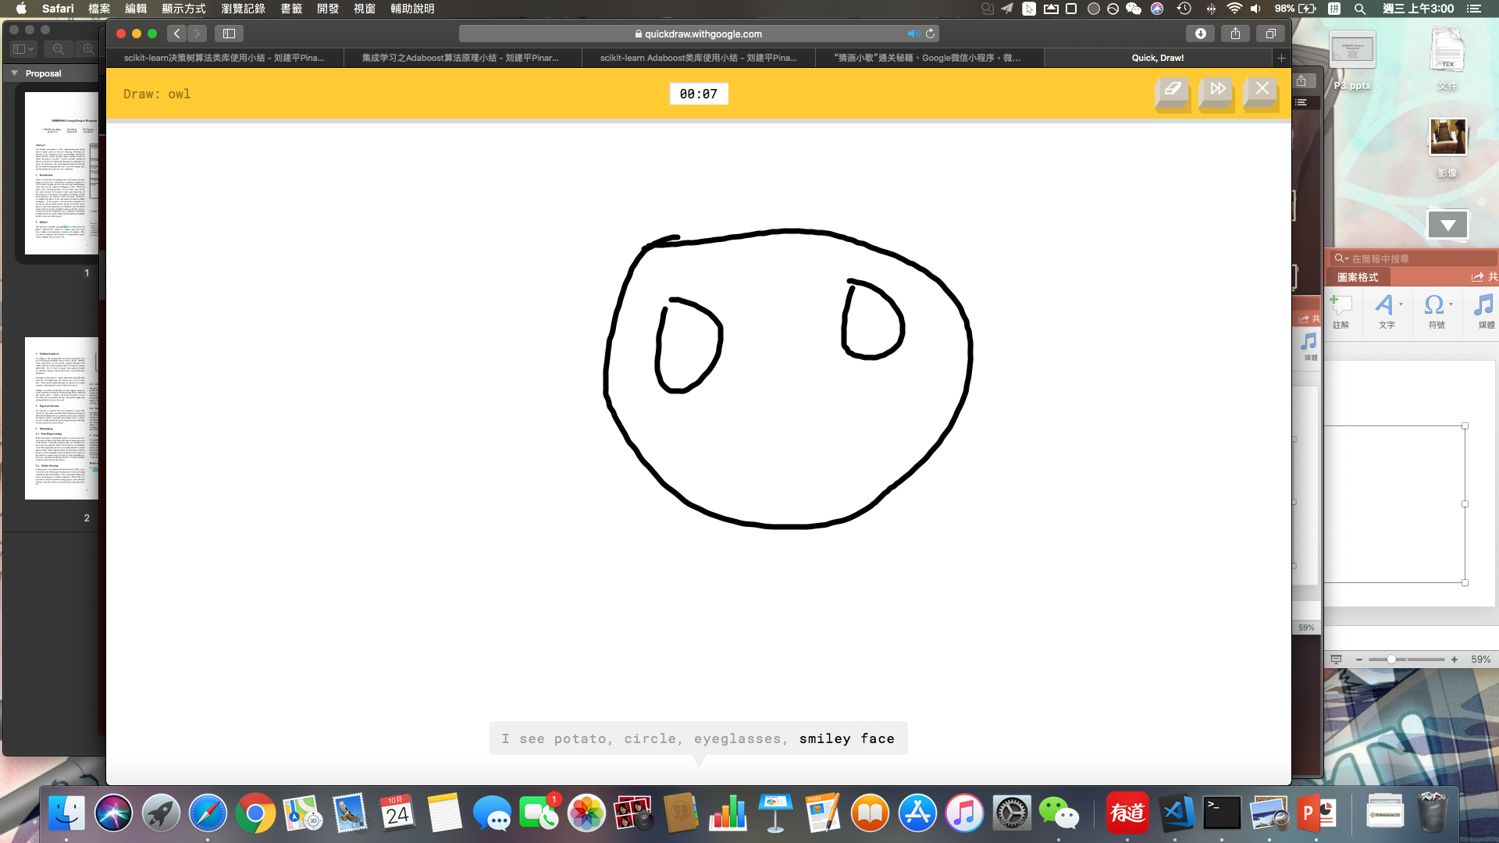
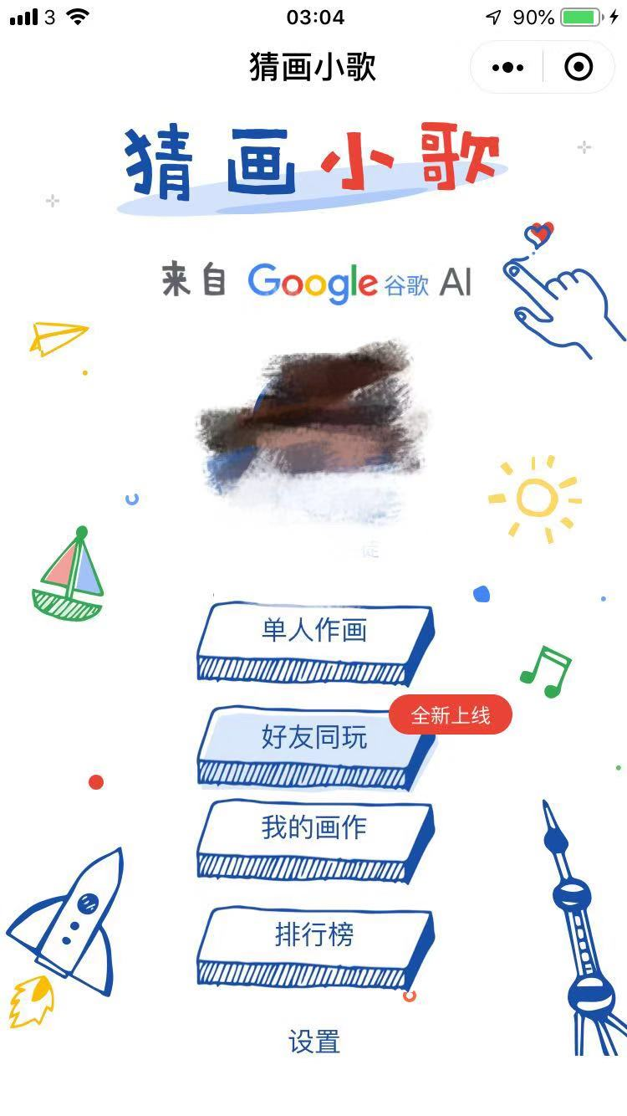
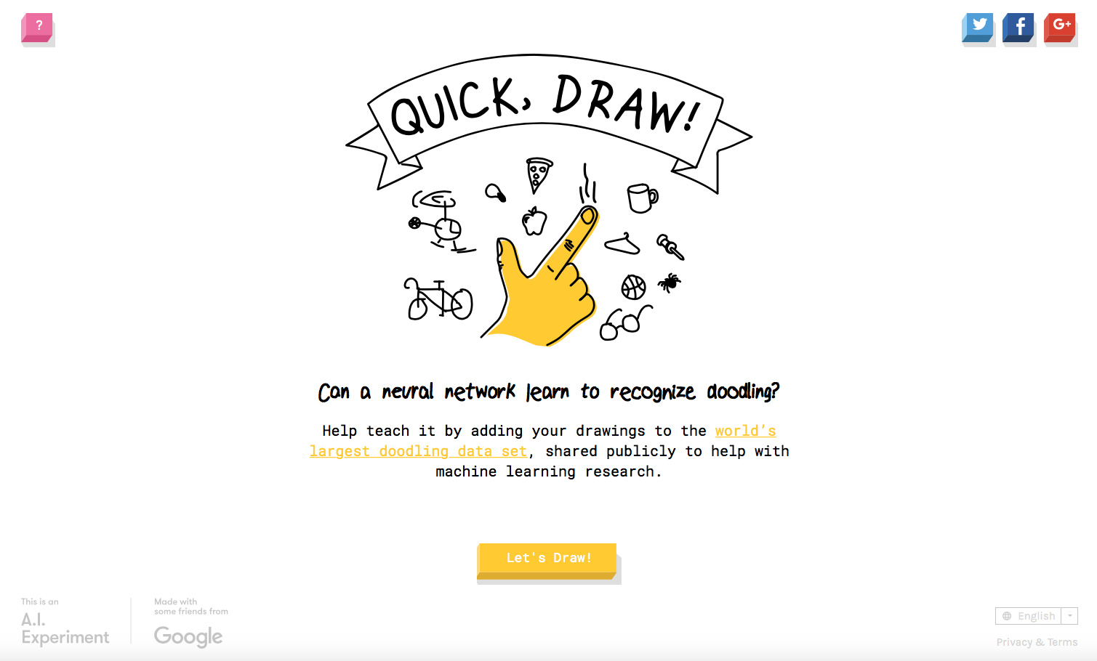
Problem Explored[1]
Doodle Recognition (Google Quickdraw)
Given a label
In Limited time: 20s
Drawing
Predict

Slide 4
Dataset

Slide 5
Dataset[2]

Slide 6
Dataset
Key | Type | Description
Key_id | 64-bit unsigned integer | A unique identifier across all drawings
Word | String | Category the player was prompted to draw
Recognized | Boolean | Whether the word was recognized by the game
Timestamp | Datetime | When the drawing was created
Country code | String | A two letter country(ISO 3166-1 alpha-2) of where the player was located.
Drawing | String | A JSON array representing the vector drawing

Slide 7
Dataset-drawing array
X,Y: Pixel coordinates (real-value)
T: time in milliseconds since the first point(integer)
Different devices display & input => Different bounding boxes & No. points
[
[ // First stroke
[x0, x1, x2, x3, ...],
[y0, y1, y2, y3, ...],
[t0, t1, t2, t3, ...]
],
[ // Second stroke
[x0, x1, x2, x3, ...],
[y0, y1, y2, y3, ...],
[t0, t1, t2, t3, ...]
],
... // Additional strokes
]

Slide 8
Dataset
A simple record
{ "key_id":"5891796615823360",
"word":"nose",
"countrycode":"AE",
"timestamp":"2017-03-01 20:41:36.70725 UTC",
"recognized":true,
"drawing":[[[129,128,129,129,130,130,131,132,132,133,...]]]
}

Slide 9
Dataset-transportation
Completed dataset takes 70G
Too large to store in laptop
Some particular categories are chosen: transportation type. e.g. Airplane, Bicycle, etc.

Slide 10
Expected Outcome

Slide 11
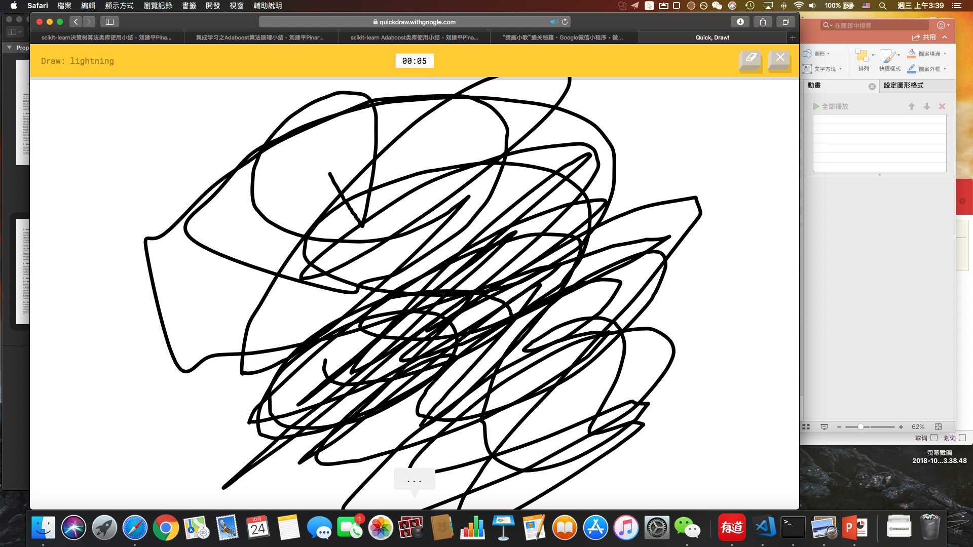
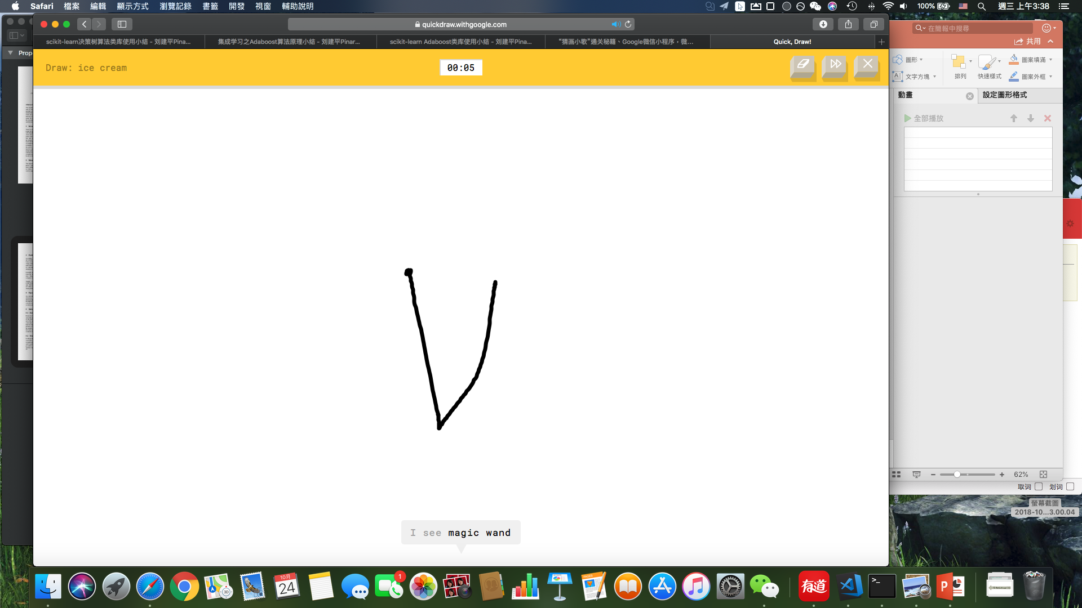
Expected outcome
High accuracy and perform well on:
Manually-labeled human drawing
Noisy data:
Incompleted sketches
Mislabeled drawing

Slide 12
References
[1]Google quickdraw https://quickdraw.withgoogle.com,2018
[2]Kaggle https://www.kaggle.com/c/quickdraw-doodle-recognition/data,2018

Slide 13
Q&A

